Slide 1

Club Awards

Slide 2
Tonight‘s Agenda
Overview of the 2 new club awards.
Explanation of the application process.
Generating ideas for educational programs
Generating ideas for community service.

Slide 3
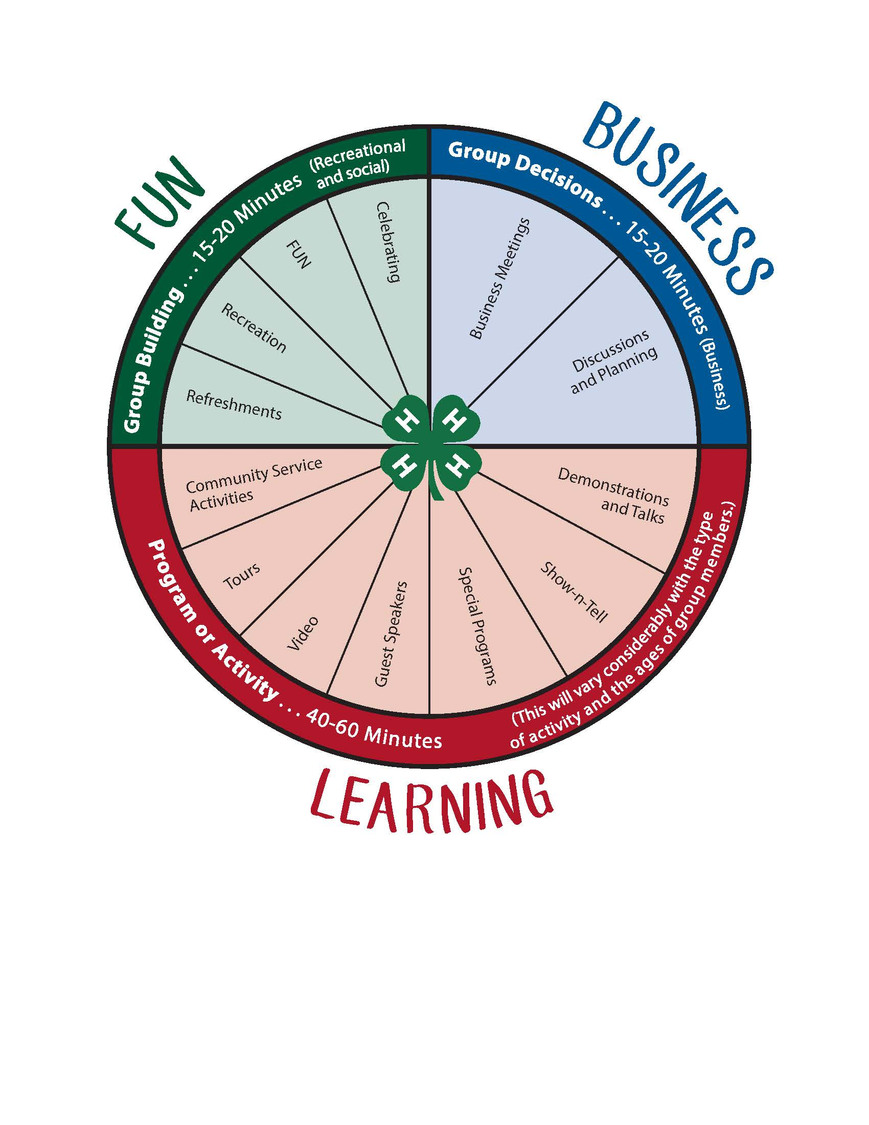
Does your club meeting look like this?

Slide 4
Focus on Learning!

Slide 5
New Awards
Head to Clear Thinking
Award of $200 will be given to 5 clubs by the Wyoming 4-H Foundation
To encourage clubs to focus on educational experiences.
Awards will not be based solely on number of activities. Awards also given for creativity, being different, going beyond, etc.
Hands to Larger Service
Award of $200 will be given to 5 clubs by the Wyoming 4-H Foundation
To encourage clubs to participate in community service.
Awards will not be based solely on number of activities. Awards also given for creativity, being different, going beyond, etc.

Slide 6

How to apply?
KEEP IT SIMPLE!
Facebook
Paper
Online
Any method works at anytime.
Awards based on October 1, 2018 – September 30, 2019 events.
Qualifying events must be turned in by November 1, 2019
We will compile them, no matter what method was used to turn them in.

Slide 7
Some things to know…
Your club has to plan the community service or education experience.
This can be done with another organization or another 4-H club.
EXAMPLE – two clubs plan a community coat drive together
EXAMPLE – the local rotary plans a carnival and 4-H member choose to have an educational booth or collect food items during the carnival
Events planned at the county level cannot be considered for the award.
EXAMPLE – the county plans a coat drive and your club donates coats
EXAMPLE – your club has a booth at a county wide project learning day

Slide 8

Head to Clearer Thinking
Members given the opportunity to learn as a club.
Demonstrations
Guest Speakers
Tours
Trips
Show and Tell
Games that promote learning and group process
Workshops

Slide 9
Use what you have…
Do club members have a talent or hobby to share?
Do parents and leaders in the club have a talent or hobby to share?
Focus on project work, what are members doing outside of club meetings.
Focus on careers – what types of jobs do parents and leaders have?
What other groups are families involved in?
Do club families have special stories to share?

Slide 10

Find resources in the community…
Police
Fire Department
National Guard
Veterinarian
Health Department
Business Owners
High School or College Clubs / Sports

Slide 11

Use the calendar to guide your learning.
Celebrate neutral holidays (try celebrating holidays from other countries).
January – celebrate a new year, make club resolutions and plans to follow them
June - Flag Day, learn how to properly fold and care for a flag
Use month / day celebrations to guide your learning.
April is National Volunteer Month – talk about volunteering and write thank you notes to local volunteers (youth learn to address an envelope).
April 4 – Vitamin C Day
Use seasons to guide your learning
Fall – talk about apples
Spring – learn about gardening
Summer – learn sun safety
Winter – learn outdoor survival skills

Slide 12
Things to keep in your back pocket.
Group Games / Teambuilding
Judging Classes
Skillathon Stations
Check the Project Information Sheets
Ask your County Extension Educator
Use the internet (Pintrest, other Extension websites)

Slide 13
Hands to Larger Service
Members given the opportunity to serve their community as a club.
Pack up food bags for the homeless.
Adopt-a-Highway.
Set up a tutoring system or reading buddies with younger students.
Clean up a local park neighborhood.
Launch an awareness campaign.
Create a “pen pal” video conferencing group with a senior citizens home.

Slide 14
Hands to Larger Service
How do you identify needs of your community.
Brainstorm with your club members
What are they involved in outside 4-H
Who do they know in the community
Talk to local government officials
local business
Parks and recreation
Senior centers
Community organizations (rotary, moose, etc)

Slide 15

Hands to larger service
Keys to success
Make it meaningful!
Make it educational!
Make it fun!

