Slide 1



4-H Club Financial Management
Notes:
Focus is on club treasurer’s role so we will mainly talk about the tool and policies that would affect them.

Slide 2

4-H Club Finances
Financial Policies
Club Financial Management
Club Audit/Review Process
Notes:
Show where they can find the tool and resources on the

Slide 3
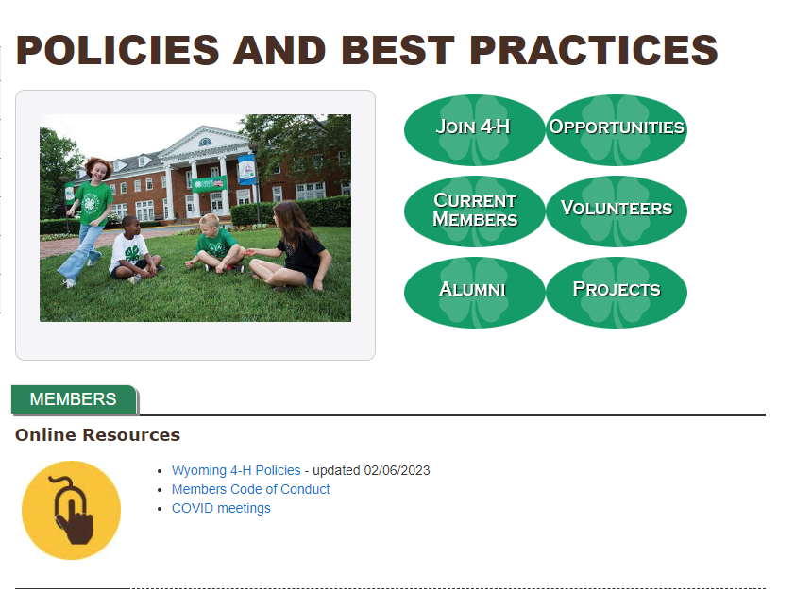
Financial Policies
https://www.uwyo.edu/4-h/current-members/policies-best-practices.html

Slide 4
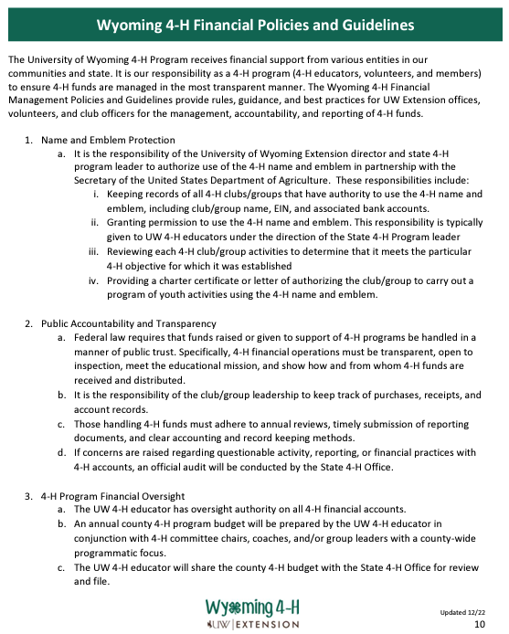
Financial Policies

Slide 5

Club Financial Management
Management of Clubs and Groups
Any club or group/committee with a checkbook needs an EIN
All 4-H accounts need 4 active signers, two being UW Extension employees
Use the Annual Treasure's Report to keep track of finances

Slide 6
Club Financial Management
Management of Clubs and Groups
Accounts need to have “4-H”in them.
One checking and one savings allowed.
  Checking $1000
  Savings $2000
  UNLESS identified purpose.
No investment accounts

Slide 7
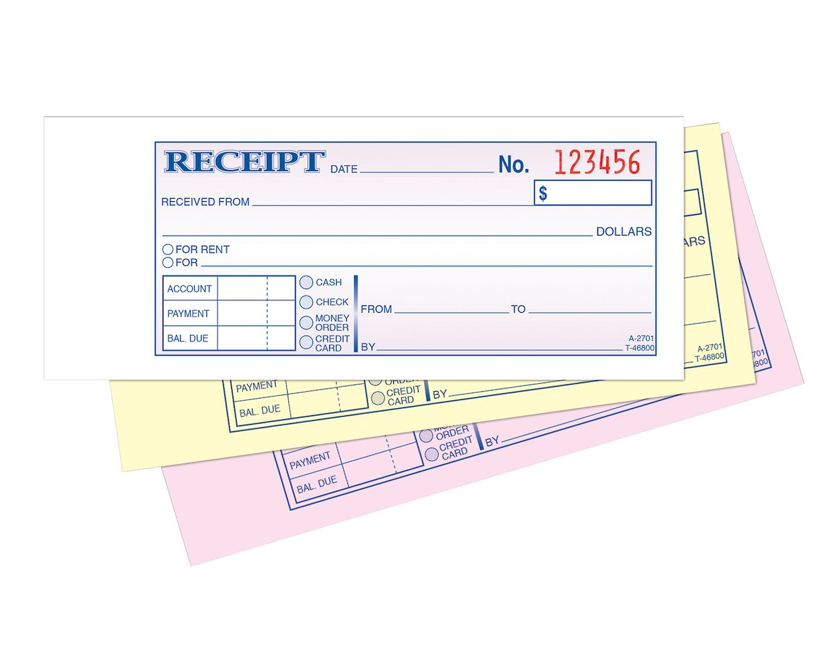
Club Financial Management
Receiving Funds - Income
Record upon receipt, don’t wait.
  Date collected
  Who collected from
  Amount collected
  Purpose

Slide 8
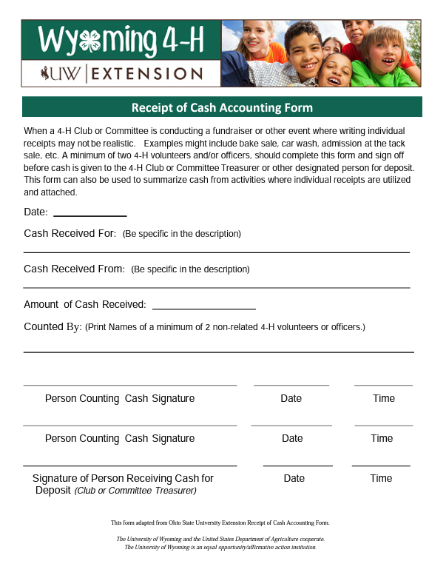
Club Financial Management
Receiving Funds - Cash
Record upon receipt, don’t wait.
  Counted by at least two people.
  Use 4-H Receipt of cash accounting form.

Slide 9

Club Financial Management
Receiving Funds - Donations
Can come from individual or business.
Be sure to write a thank you note.
  If over $150 use the Wyoming 4-H Donation Letter
Do not accept donations from entities whose business is not in line with the 4-H mission.

Slide 10
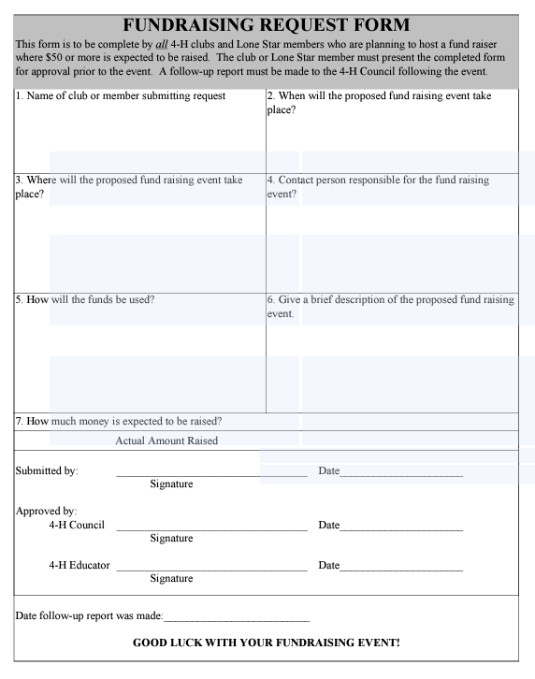
Club Financial Management
Receiving Fund - Fundraising
Request ahead by filling out Income and Fundraising Request Form
Only fundraise for a purpose.
Keep fundraising in line with youth development principles

Slide 11
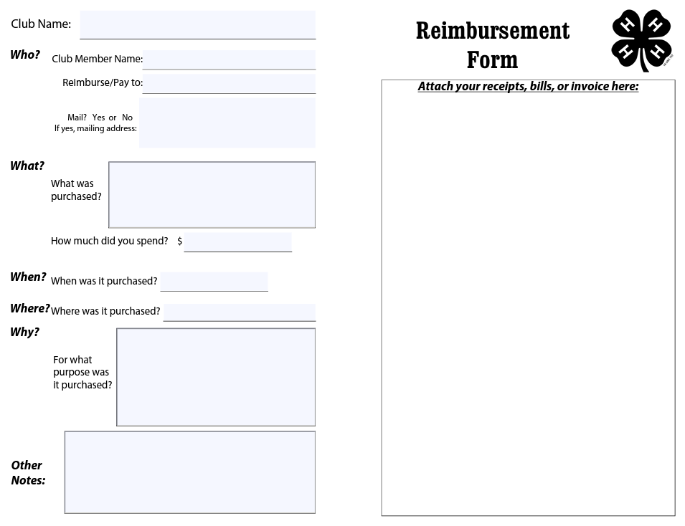
Club Financial Management
Disbursing Funds - Expenses
Money spent should be reflected in the minutes.
Receipts/Invoices should say
  What was purchased
  Whom the purchase was made from

Slide 12
Club Financial Management
Disbursing Funds – Cash Withdrawal
Must be made at the bank by an account signer
Document on the bank receipt what it is for
If you purchase items with the cash mark that on the receipt.
Don’t write checks to cash, go to the bank.

Slide 13
Club Financial Management
Disbursing Funds – Other
No signer can write a check to themselves.
No personal purchases can be made with club funds.
Your club can have one debit card.
  No cash advances, cash back with purchase, or use of ATM allowed.
  Turn in receipts immediately if Debit card is used.
NO credit cards allowed.

Slide 14
Club Financial Management
Online Processing
Only one per club – pick a platform you will use
Follow previous rules
  Purchases must be in the minutes.
  Receipts must be provided.
  Set up a separate e-mail and password for the club so that all information stays with the club and not the person setting up the account.

Slide 15
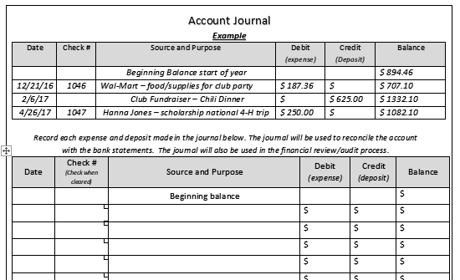
Club Financial Management
Account Reconciliation
Responsibility falls on the treasurer with help from a volunteer leader.
Use the 4-H Treasurer Book to keep track.
Reconcile with bank each month.

Slide 16

Club Financial Management
Receipts and Bank Statements
12 Pocket Expandable File Folder
Great way to organize your finance documents
Retain records for at least 3 years

Slide 17
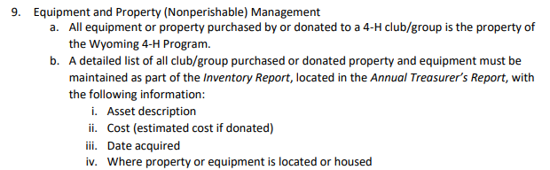
Financial Policies

Slide 18
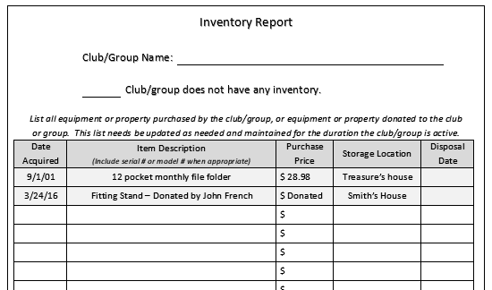
Club Financial Management

Slide 19
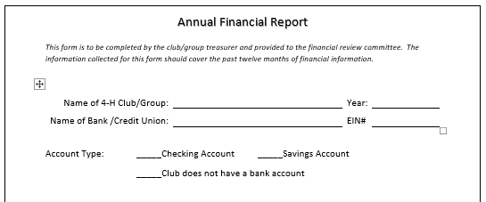
Club Audit/Review

Slide 20
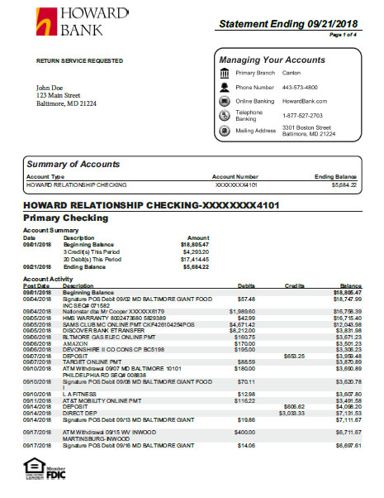
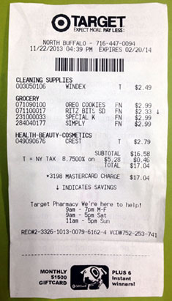
Club Audit/Review
Treasurers’ Report
Bank Statements
Receipts and Deposit Slips

Slide 21
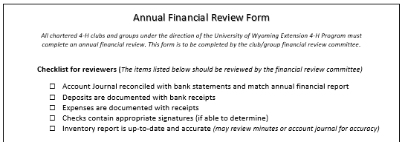
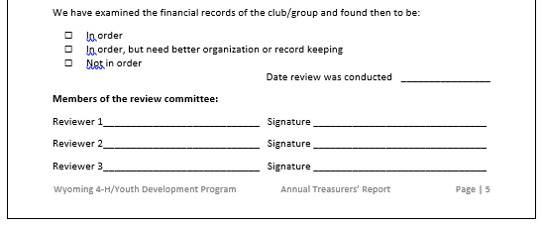
Club Audit/Review

Slide 22
Questions? storbert@uwyo.edu

